Slide 1
International english
A VISUAL PRESENTATION

Slide 2
Step 1 - Working with elements from the cover of E2
Recognizing the elements
Study the front and back cover of E2.
Compile individual lists of as many elements as possible (5 minutes).

Slide 3
Step 2 Working with elements from the cover of E2
Interpreting the elements
Choose one element and write one sentence where you suggest why it might have been put on the cover of the book.
Write similar sentences for as many elements as possible.
Firstly: Individual writing
Secondly: Plenary discussion

Slide 4
Step 3 Working with elements from the cover of E2
Connecting cover and content
Write one coherent paragraph where you answer the following:
What does the cover suggest about the content of the book?

Slide 5
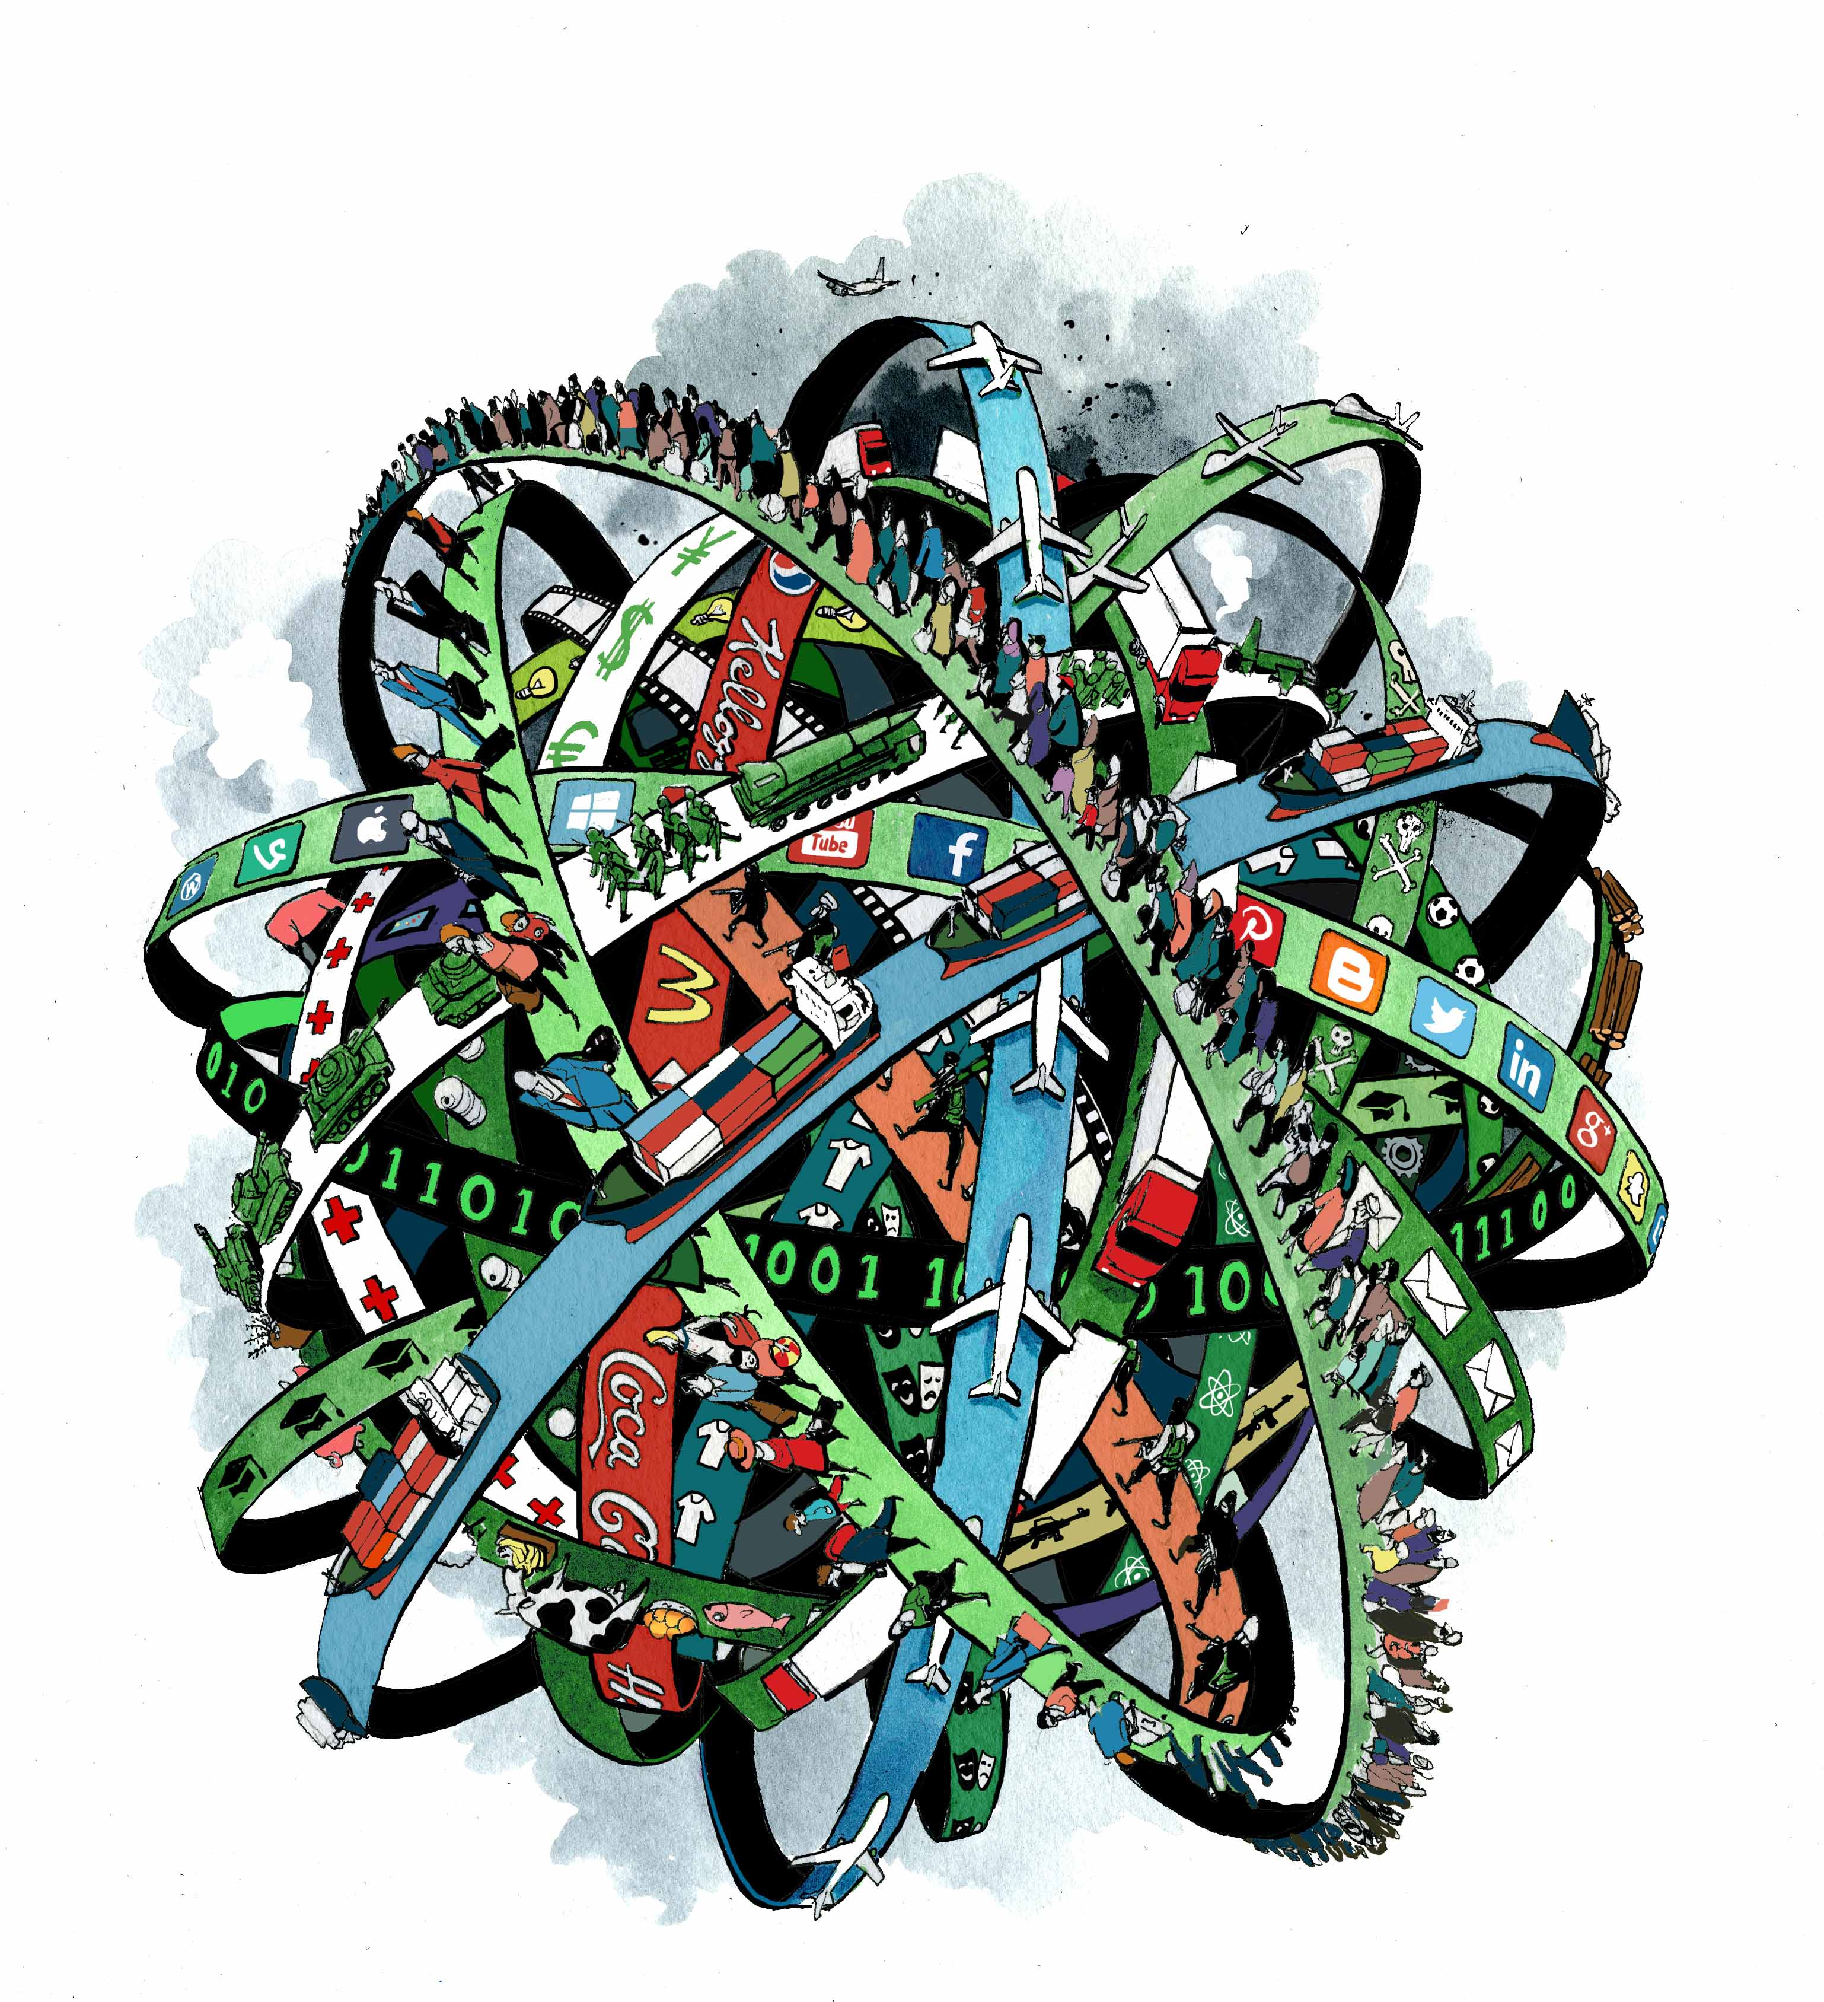
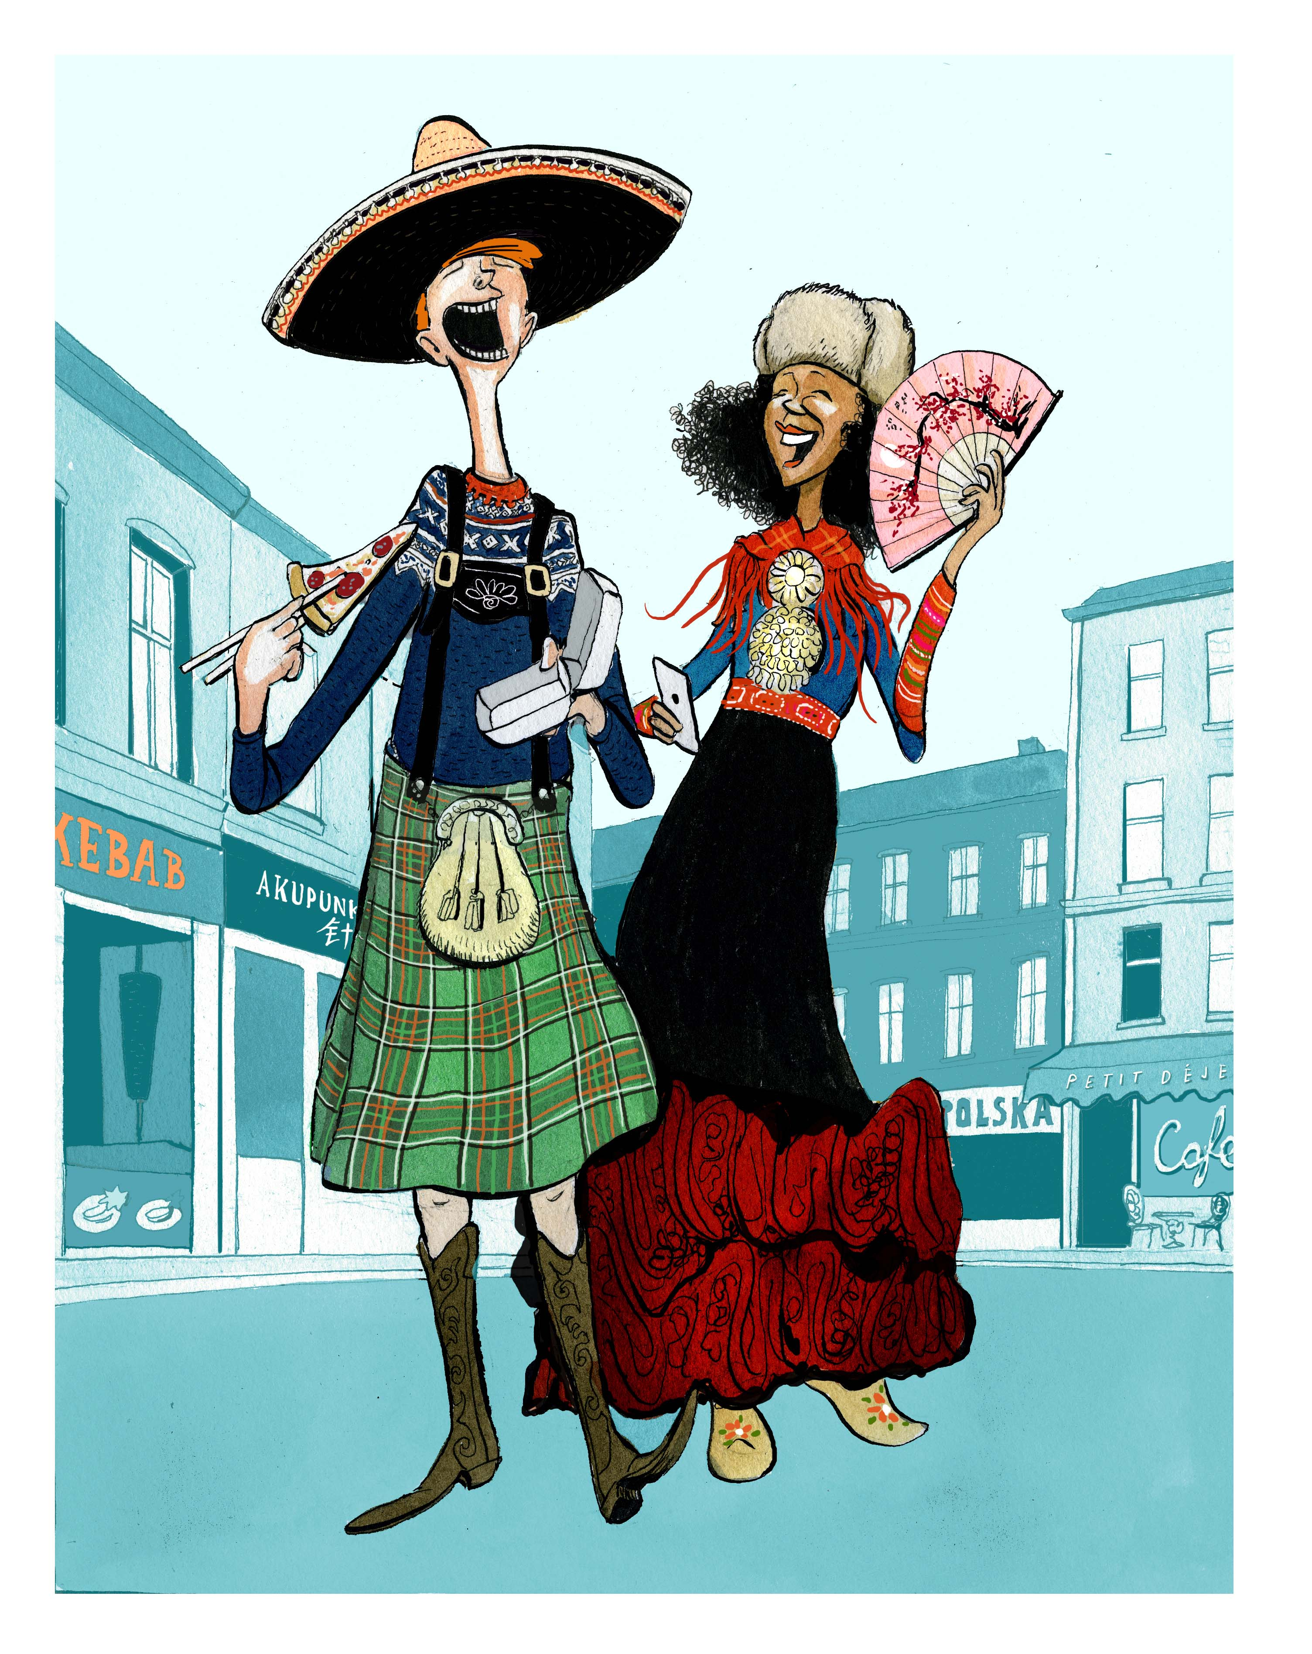
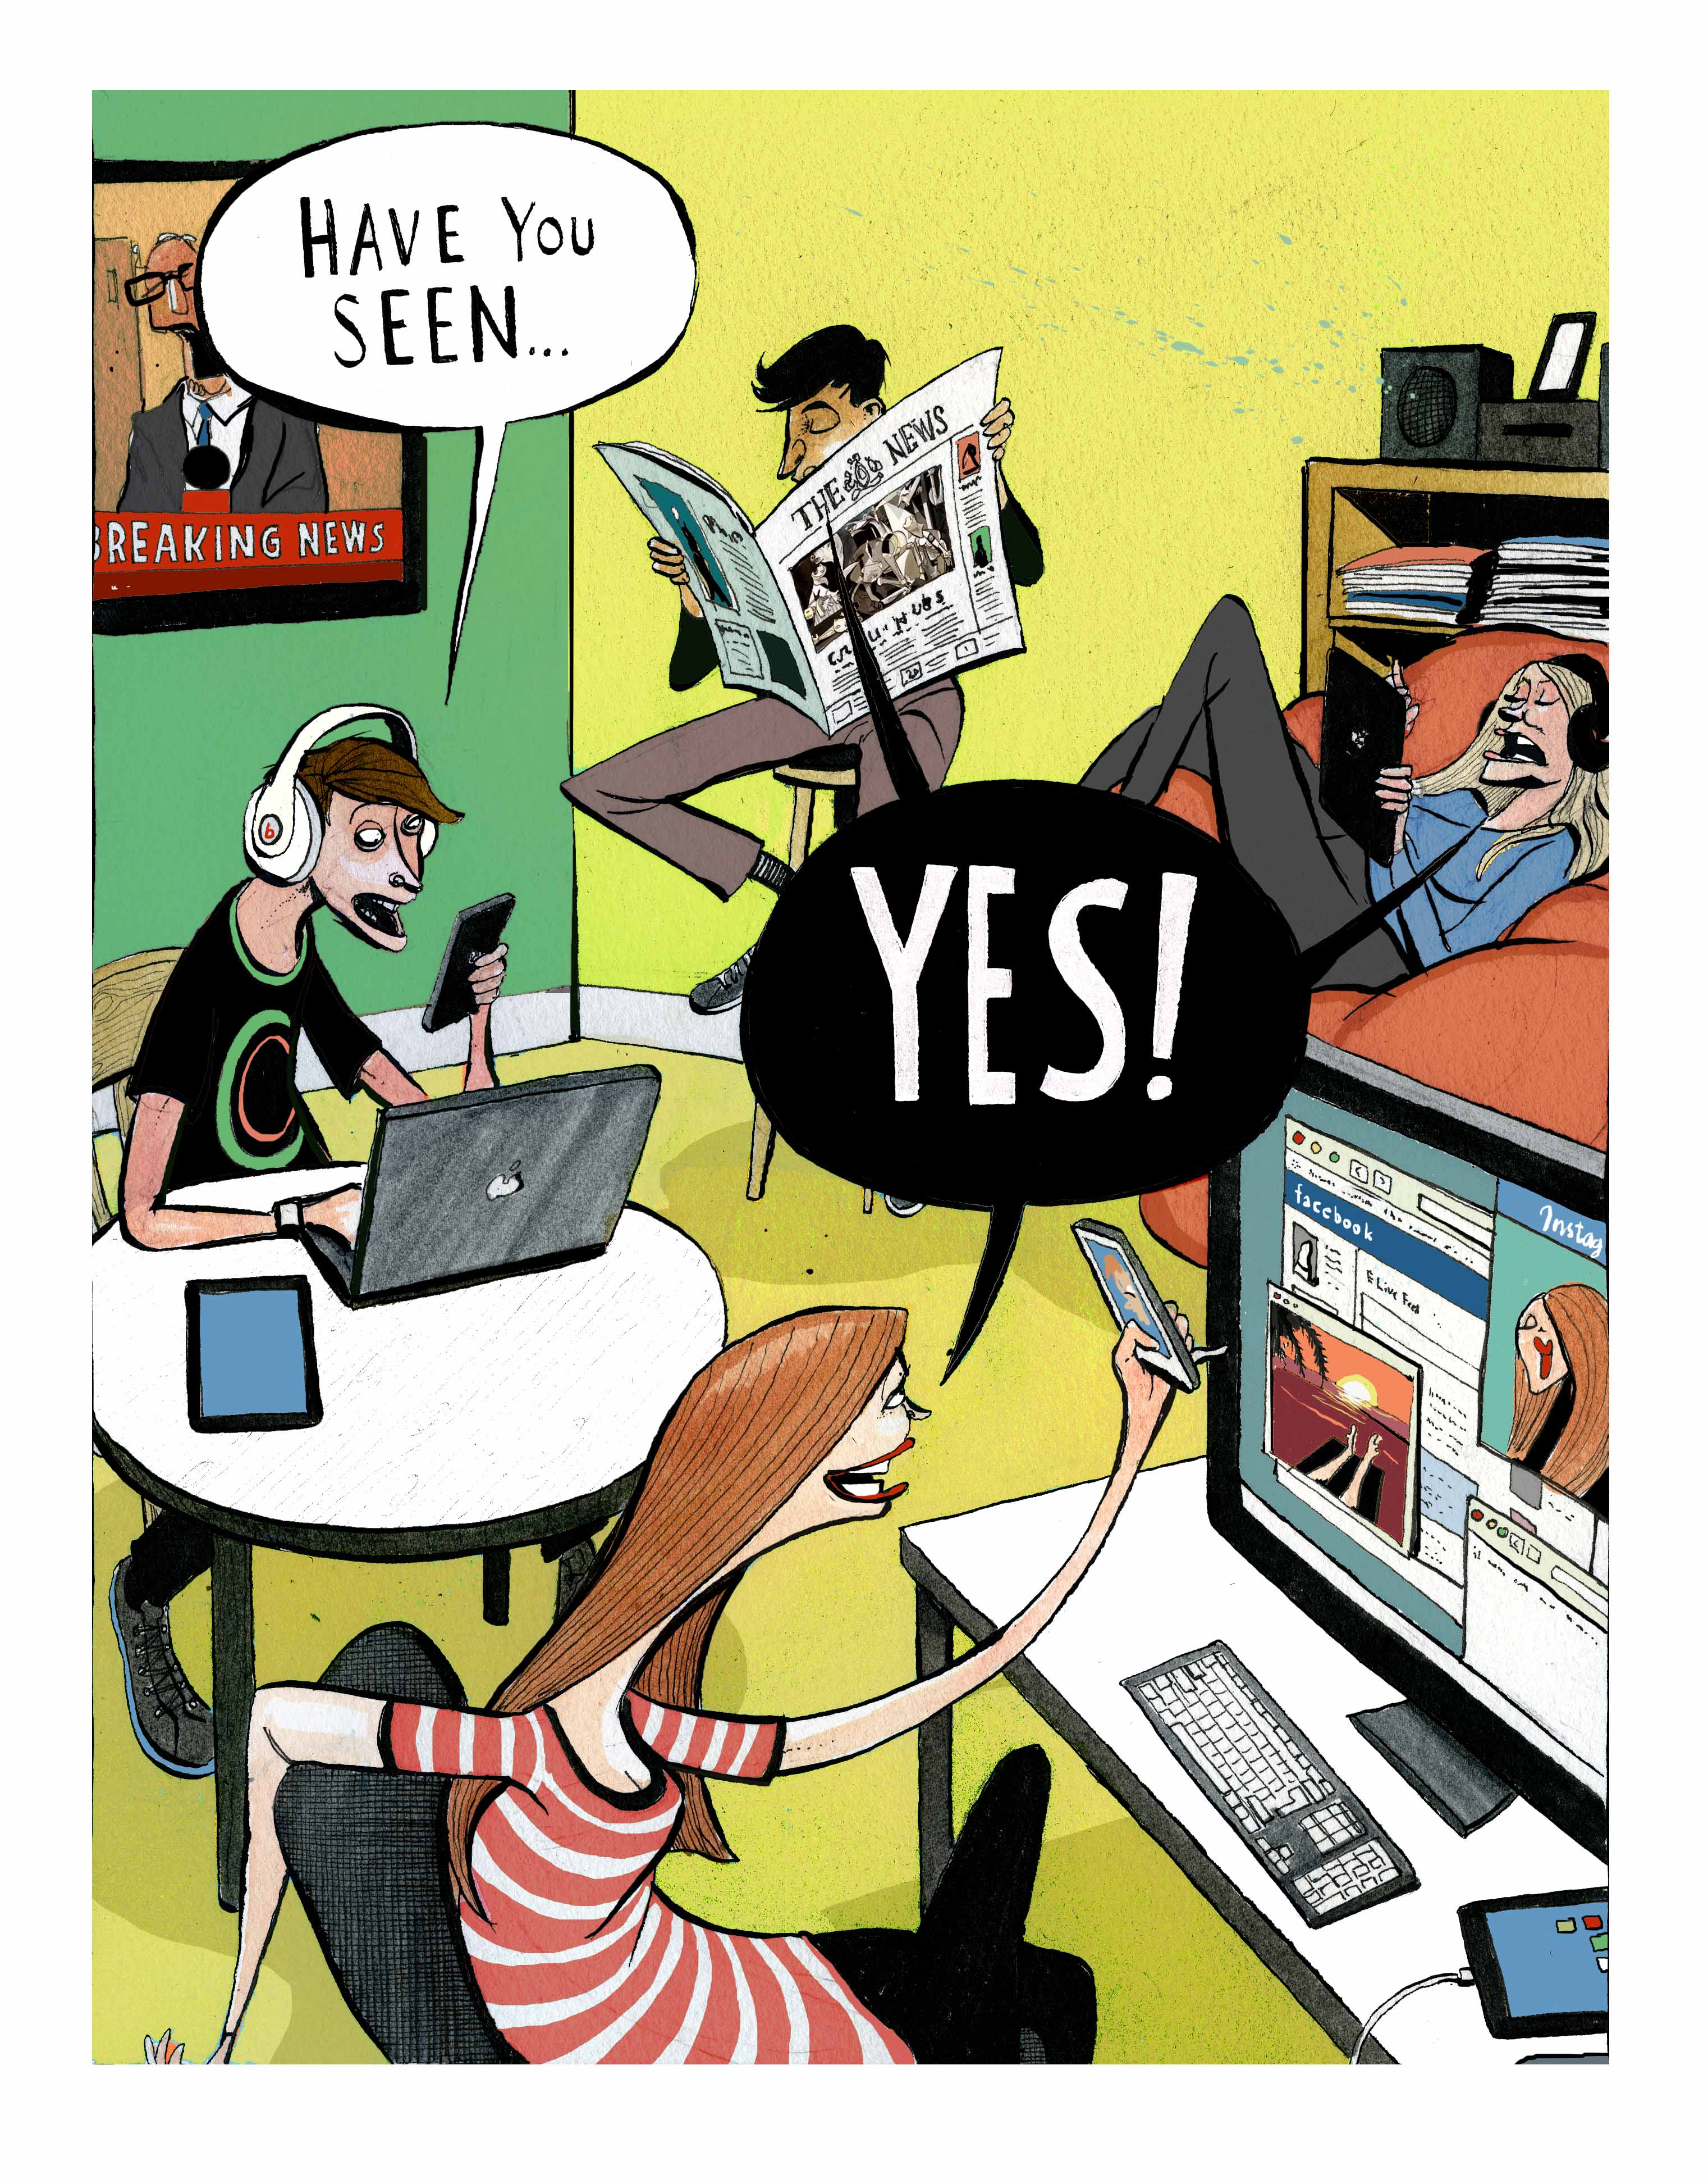
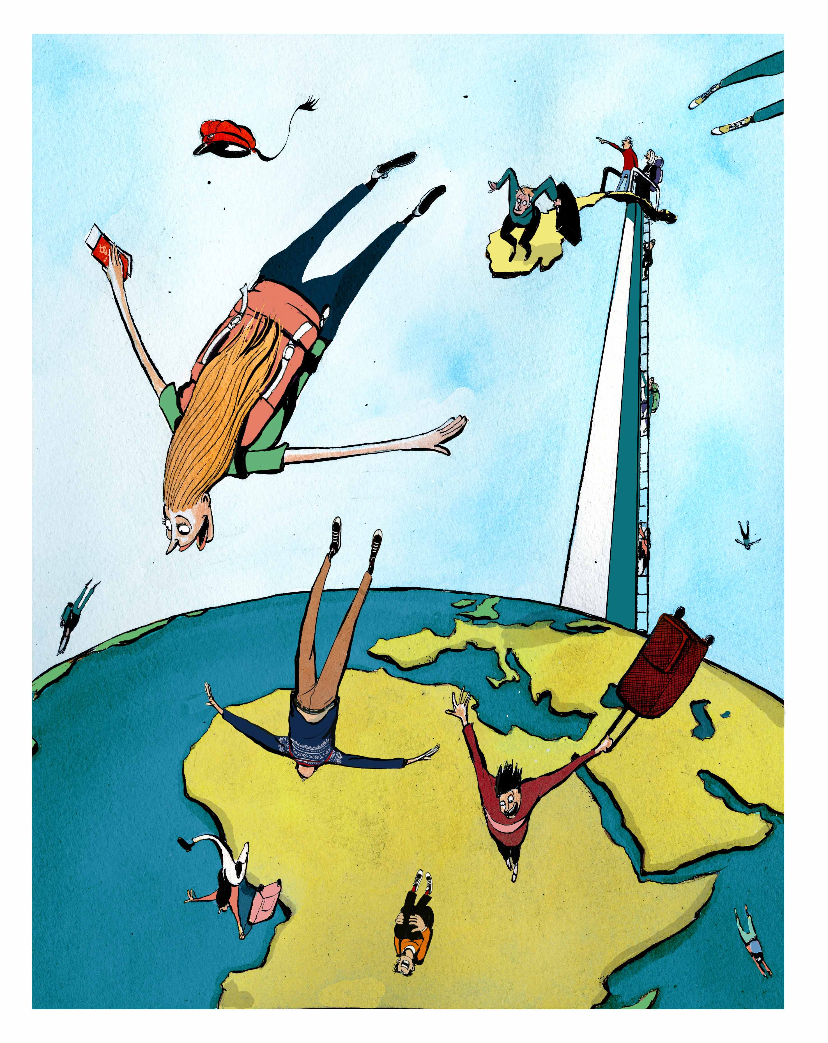
Working with the chapter illustrations
Cartoonist Morten Mørland has made introductory illustrations to each of the four chapters in Part 2, “Going International”. (http://morlandcartoon.co.uk/ )

Slide 6
Step 4: Working with the chapter illustrations
Suggesting themes
Study the illustrations. Next, suggest a theme for each chapter.

Slide 7
Step 5: Working with the chapter illustrations
Describing an illustration
In pairs: Choose one of Mørland’s chapter illustrations and describe, in detail, what you see.

Slide 8
Step 6: Working with the chapter illustrations
Reflecting on the competence aims
Discuss in class: How do the illustrations reflect the “Culture, society and literature” competence aims of International English?

Slide 9
Culture, society and literature - Aims
locate, elaborate on and discuss international educational options and employment options
analyse and assess the role of some English-language media in international society
elaborate on and discuss various aspects of multicultural societies in the English-speaking world
reflect on how cultural differences and dissimilar value systems can affect communication
elaborate on and discuss a number of international and global challenges
elaborate on and discuss a selection of literature and factual prose from the period 1950 up to the present
analyse, elaborate on and discuss at least one lengthy literary work and one film
present a major in-depth project on a topic from International English or another subject from his or her own programme area and assess the process.

Slide 10
Suggested answers

Slide 11
Steps 1 – 3 Working with elements from the cover of E2
Element | Possible reference to theme
Greek temple | university, education
Twitter symbol | social media, communication
Cloud | climate
Squiggly arrows | global warming
WiFi | Internet communication
Handcuffs | law and order
SoundCloud symbol, raindrops | music, or acid rain
Rhinoceros | Africa, endangered species
Gun sight | violence, war, target
Sydney Opera House | Australia
Statue of Liberty with Hannibal Lecter mask | USA, freedom, violation of human rights, film
Speech bubble saying «GREAT» | America, Donald Trump, politics
Speech bubble with question mark | unanswered question, questioning the comment “GREAT”
Feminist | girls’/women’s rights, equality
Windmills | alternative energy sources
Credit cards | money, economy
Elephant and donkey | Democrats and Republicans, US political parties
Mexican border pattern | fence, wall, immigration, diversity
Uncle Sam’s hat on eye | Big Brother is watching you
Instagram symbol | social media
Heart | “likes” (Facebook/Instagram)/love
Snapchat symbol | social media
Computer mouse | electronic communication, using ICT
Election, ballot | Democracy, citizenry
Map marker | globalization
Musical notes | music
Wine bottle, wine glass, grapes | California, Australia, South Africa, etc.
Front
cover

Slide 12
Steps 1 – 3 Working with elements from the cover of E2
Element | Possible reference to theme
Globe with Africa in the front | Africa, the international community
Hand with henna pattern | Asian and African culture
Trees with leaves on the back side of a cloud | climate
Tablet with GO GO GO | using technology for motivation
Speech bubble with U, pointing at tablet | this is about you (me as a student)
Fish leaping form one goldfish bowl to another | migration
Sale label | consumerism, sustainability
Sombrero and moustache | Mexico, Mexicans
Diploma | education, graduation
Computer screen with magnifying glass | finding sources, close reading, electronic surveillance
Double-decker bus, YOLO | London, You Only Live Once
Pencil | writing, studying
Lab equipment | science
Briefcase | work
Lips and * | kiss, love
Musical notes and guitar | music
Malala | freedom of speech, girls’/women’s rights
Back cover

Slide 13
Steps 4 – 6 Working with the chapter illustrations
Aim: “elaborate on and discuss a number of international and global challenges”
Global Issues: The illustration consists of ribbons that make up the shape of a globe.
Ribbon | Possible theme
Migrants/commuters | people on the move
Military parades | war
Binary digits | computers
Coca Cola, Pepsi, McDonald’s, Kellogg’s | international food and drink companies
Tragedy and comedy masks | live entertainment, theatre
Film | movie industry
Red crosses | health care, charity, international organizations
Cargo ships | sea transport
Trucks | road transport
Airplanes | air transport, travel
Envelopes | postal services
EUR, USD, JPY, symbols | money, finance
Graduation hats | education
Lightbulbs | energy
Machine guns | weapons trade
Apple, Microsoft, YouTube, Facebook, Pinterest, Bing, Twitter, LinkedIn, Google+, Snapchat | Internet and social media
Drones | surveillance/war
Footballs | sports
T-shirts | clothes, consumerism
Cow, sheep, poultry | food production, agriculture
Sculls and crossbones | piracy
Logs | Forestry, sustainability

Slide 14
Steps 4 – 6 Working with the chapter illustrations
Multicultural Societies: The illustration depicts a boy and a girl walking across a square.
Aims:
“elaborate on and discuss various aspects of multicultural societies in the English-speaking world”
“reflect on how cultural differences and dissimilar value systems can affect communication”
Boy | Influences from
Wears boots and sombrero | USA, Mexico
Dressed in kilt and Marius sweater | Scotland, Norway
Eats pizza with chopsticks from fast food box | Italy, China, USA
Girl | Influences from
Wears clogs and ushanka (Russian winter hat) | Holland, Russia
Dressed in flamenco dress, top with patterns from traditional Sami costume | Spain, Northern Scandinavia/Russia
Holds hand fan, smartphone | China, USA
Square | Influences from
Kebab shop | Turkey
Acupuncture clinic | China
Café | France
Polish café, restaurant or shop | Poland

Slide 15
Steps 4 – 6 Working with the chapter illustrations
Aim: “analyse and assess the role of some English-language media in international society”
The media
Two boys and two girls are surrounded by different media. The boy on the left has found something he wants to inform the others about, but they already know. There is breaking news on a TV on the wall and there is a sound system on top of a bookshelf.
The boy on the left gets information from a smartphone, tablet, laptop computer and headphones.
The girl on the left gets information from a desktop computer and tablet (on charge). She also takes a selfie with a smartphone.
The boy on the right gets information from a newspaper.
The girl on the right gets information from a tablet and headphones.

Slide 16
Steps 4 – 6 Working with the chapter illustrations
Aim: “locate, elaborate on and discuss international educational options and employment options”
Work and Education
A number of young people are climbing a diving tower. Some have already taken “the great leap” into the world from the diving board itself which has the shape of Norway. A girl in midair has lost her “russ cap” and is holding a passport in her hand while others hold on to bags or briefcases. They will all land in different places.

